Slide 1
Chapter 2 Application Layer
Notes:
Version History
8.1. Updates throughout, including a lot more animations. These are the ppt files used to make Chapter 2 online lectures in Sept. 2020.
8.0 (April 2020)
All slides reformatted for 16:9 aspect ratio
All slides updated to 8th edition material
Use of Calibri font, rather that Gill Sans MT
Add LOTS more animation throughout

Slide 2
Application layer: overview
Principles of network applications
Web and HTTP

Slide 3
Some network apps
social networking
Web
text messaging
e-mail
multi-user network games
streaming stored video (YouTube, Hulu, Netflix)
P2P file sharing
voice over IP (e.g., Skype)
real-time video conferencing (e.g., Zoom)
Internet search
remote login

Slide 4
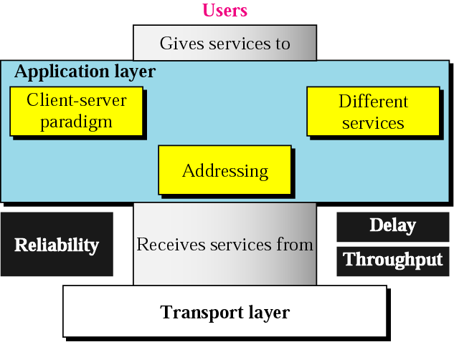
Application layer
This layer allows people to use the Internet
Other 4 layers are just made so people can use application programs

Slide 5
Internet applications
Application | Application layer protocol | Transport protocol
E-mail | SMTP | TCP
Remote terminal access | telnet | TCP
Web | HTTP | TCP
File transfer | FTP | TCP
Streaming multimedia | Proprietary | TCP or UDP
Internet telephony | Proprietary | Typically UDP

Slide 6
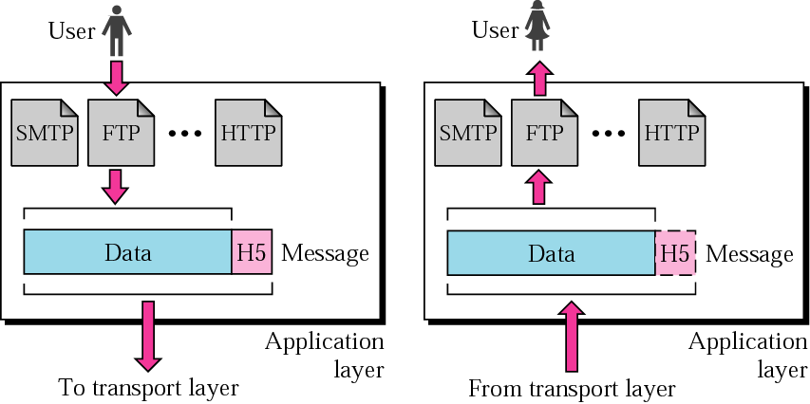
Application layer

Slide 7
















Creating a network app
application
transport
network
data link
physical
write programs that:
run on (different) end systems
communicate over network
e.g., web server software communicates with browser software
no need to write software for network-core devices
network-core devices do not run user applications
applications on end systems allows for rapid app development, propagation
mobile network
national or global ISP
local or regional ISP
home network
content
provider
network
application
transport
network
data link
physical
application
transport
network
data link
physical
datacenter
network
enterprise
network

Slide 8
Application Architecture
Client-server Architecture
Peer to peer Architecture

Slide 9
Client-server architecture
server:
always-on host
permanent IP address
often in data centers, for scaling
clients:
contact, communicate with server
may be intermittently connected
may have dynamic IP addresses
do not communicate directly with each other
examples: HTTP, IMAP, FTP
mobile network
national or global ISP
local or regional ISP
home network
content
provider
network
datacenter
network
enterprise
network

Slide 10
Peer-peer architecture
no always-on server
arbitrary end systems directly communicate
peers request service from other peers, provide service in return to other peers
self scalability – new peers bring new service capacity, as well as new service demands
peers are intermittently connected and change IP addresses
complex management
example: P2P file sharing [BitTorrent]
mobile network
national or global ISP
local or regional ISP
home network
content
provider
network
datacenter
network
enterprise
network

Slide 11
Processes communicating
process: program running within a host
within same host, two processes communicate using inter-process communication (defined by OS)
processes in different hosts communicate by exchanging messages
clients, servers
client process: process that initiates communication
server process: process that waits to be contacted
note: applications with P2P architectures have client processes & server processes

Slide 12

Sockets
process sends/receives messages to/from its socket
socket analogous to door
sending process shoves message out door
sending process relies on transport infrastructure on other side of door to deliver message to socket at receiving process
two sockets involved: one on each side
application
socket
application
controlled by
app developer
process
process
transport
transport
network
network
controlled
by OS
link
Internet
link
physical
physical

Slide 13
Ports
A numerical identifier (0–65535) used to distinguish different services on the same IP address.
Example: Port 80 for HTTP, Port 443 for HTTPS.
Think of it like an apartment number inside a building (the IP address is the building’s street address).

Slide 14
Sockets
A combination of
IP Address
Port Number
Protocol (TCP/UDP)
This uniquely identifies one endpoint of a network connections message out door
Example
192.168.1.10:443 over TCP is one socket

Slide 15
Addressing processes
to receive messages, process must have identifier
host device has unique 32-bit IP address
Q: does IP address of host on which process runs suffice for identifying the process?
identifier includes both IP address and port numbers associated with process on host.
example port numbers:
HTTP server: 80
mail server: 25
to send HTTP message to gaia.cs.umass.edu web server:
IP address: 128.119.245.12
port number: 80
more shortly…
A: no, many processes can be running on same host

Slide 16
An application-layer protocol defines:
types of messages exchanged,
e.g., request, response
message syntax:
what fields in messages & how fields are delineated
message semantics
meaning of information in fields
rules for when and how processes send & respond to messages
open protocols:
defined in RFCs, everyone has access to protocol definition
allows for interoperability
e.g., HTTP, SMTP
proprietary protocols:
e.g., Skype, Zoom

Slide 17
What transport service does an app need?
data integrity
some apps (e.g., file transfer, web transactions) require 100% reliable data transfer
other apps (e.g., audio) can tolerate some loss
throughput
some apps (e.g., multimedia) require minimum amount of throughput to be “effective”
other apps (“elastic apps”) make use of whatever throughput they get
timing
some apps (e.g., Internet telephony, interactive games) require low delay to be “effective”
security
encryption, data integrity, …

Slide 18
Transport service requirements: common apps
application
file transfer/download
e-mail
Web documents
real-time audio/video
streaming audio/video
interactive games
text messaging
data loss
no loss
no loss
no loss
loss-tolerant
loss-tolerant
loss-tolerant
no loss
throughput
elastic
elastic
elastic
audio: 5Kbps-1Mbps
video:10Kbps-5Mbps
same as above
Kbps+
elastic
time sensitive?
no
no
no
yes, 10’s msec
yes, few secs
yes, 10’s msec
yes and no

Slide 19
Internet transport protocols services
TCP service:
reliable transport between sending and receiving process
flow control: sender won’t overwhelm receiver
congestion control: throttle sender when network overloaded
connection-oriented: setup required between client and server processes
does not provide: timing, minimum throughput guarantee, security
UDP service:
unreliable data transfer between sending and receiving process
does not provide: reliability, flow control, congestion control, timing, throughput guarantee, security, or connection setup.
Q: why bother? Why is there a UDP?

Slide 20
Internet applications, and transport protocols
application
layer protocol
FTP [RFC 959]
SMTP [RFC 5321]
HTTP [RFC 7230, 9110]
SIP [RFC 3261], RTP [RFC 3550], or proprietary HTTP [RFC 7230], DASH
WOW, FPS (proprietary)
application
file transfer/download
e-mail
Web documents
Internet telephony
streaming audio/video
interactive games
transport protocol
TCP
TCP
TCP
TCP or UDP
TCP
UDP or TCP

Slide 21
Securing TCP
Vanilla TCP & UDP sockets:
no encryption
cleartext passwords sent into socket traverse Internet in cleartext (!)
Transport Layer Security (TLS)
provides encrypted TCP connections
data integrity
end-point authentication
TLS implemented in application layer
apps use TLS libraries, that use TCP in turn
cleartext sent into “socket” traverse Internet encrypted
more: Chapter 8

Slide 22
Application layer: overview
Principles of network applications
Web and HTTP

Slide 23
WWW
World Wide Web
Introduced in 1991
originated from the CERN High-Energy Physics laboratories in Geneva, Switzerland.

Slide 24
The Web: Some Jargon
Web page
consists of objects (HTML file, JPEG image, GIF image…)
addressed by URL
Most Web pages consist of
base HTML page
several referenced objects
URL
A standard way of specifying the location of an object, typically a web page, on the Internet
User agent for Web is called a browser
MS Internet Explorer
Server for Web is called a Web server

Slide 25
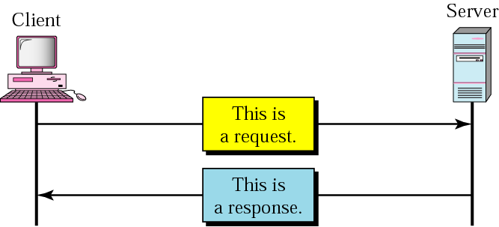
HyperText Transfer Protocol
Web’s application layer protocol
Used to access data on the World Wide Web
Rapid jump from one document to another
Client-server model
client: browser that requests, receives, “displays” web objects
server: Web server sends objects in response to request
uses one TCP connection on the well-known port 80

Slide 26
Web and HTTP
web page consists of objects, each of which can be stored on different Web servers
object can be HTML file, JPEG image, Java applet, audio file,…
web page consists of base HTML-file which includes several referenced objects, each addressable by a URL, e.g.,
www.someschool.edu/someDept/pic.gif
host name
path name

Slide 27
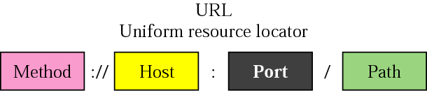
URL - continued
method
protocol used to retrieve the document (FTP, HTTP, …)
host
a computer where the info is located
the name of the computer can be an alias (not necessary www)
port
optional port # of the server
path
the path name of the file where the info is located

Slide 28
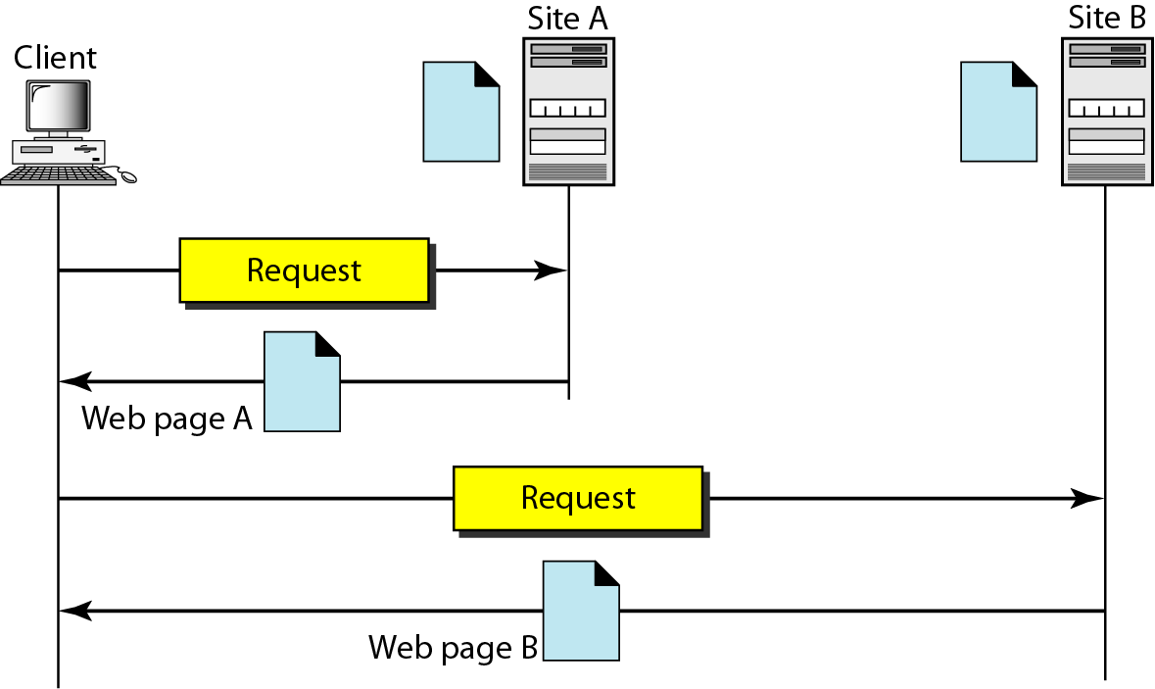
Figure 27.1 Architecture of WWW

Slide 29

HTTP overview
HTTP: hypertext transfer protocol
Web’s application-layer protocol
client/server model:
client: browser that requests, receives, (using HTTP protocol) and “displays” Web objects
server: Web server sends (using HTTP protocol) objects in response to requests
HTTP request
PC running
Firefox browser
HTTP response
HTTP request
server running
Apache Web
server
HTTP response
iPhone running
Safari browser

Slide 30
HTTP overview (continued)
HTTP uses TCP:
client initiates TCP connection (creates socket) to server, port 80
server accepts TCP connection from client
HTTP messages (application-layer protocol messages) exchanged between browser (HTTP client) and Web server (HTTP server)
TCP connection closed
HTTP is “stateless”
server maintains no information about past client requests
aside
protocols that maintain “state” are complex!
past history (state) must be maintained
if server/client crashes, their views of “state” may be inconsistent, must be reconciled

Slide 31
HTTP connections: two types
Non-persistent HTTP
TCP connection opened
at most one object sent over TCP connection
TCP connection closed
downloading multiple objects required multiple connections
Persistent HTTP
TCP connection opened to a server
multiple objects can be sent over single TCP connection between client, and that server
TCP connection closed

Slide 32
Non-persistent HTTP: example
User enters URL:
www.someSchool.edu/someDepartment/home.index
(containing text, references to 10 jpeg images)
1a. HTTP client initiates TCP connection to HTTP server (process) at www.someSchool.edu on port 80
1b. HTTP server at host www.someSchool.edu waiting for TCP connection at port 80 “accepts” connection, notifying client
2. HTTP client sends HTTP request message (containing URL) into TCP connection socket. Message indicates that client wants object someDepartment/home.index
3. HTTP server receives request message, forms response message containing requested object, and sends message into its socket
time

Slide 33
Non-persistent HTTP: example (cont.)
User enters URL:
www.someSchool.edu/someDepartment/home.index
(containing text, references to 10 jpeg images)
4. HTTP server closes TCP connection.
5. HTTP client receives response message containing html file, displays html. Parsing html file, finds 10 referenced jpeg objects
6. Steps 1-5 repeated for each of 10 jpeg objects
time

Slide 34
Non-persistent HTTP: response time
RTT (definition): time for a small packet to travel from client to server and back
HTTP response time (per object):
one RTT to initiate TCP connection
one RTT for HTTP request and first few bytes of HTTP response to return
object/file transmission time
initiate TCP
connection
RTT
request file
RTT
time to
transmit
file
file received
time
time
Non-persistent HTTP response time = 2RTT+ file transmission time

Slide 35
Persistent HTTP (HTTP 1.1)
Non-persistent HTTP issues:
requires 2 RTTs per object
OS overhead for each TCP connection
browsers often open multiple parallel TCP connections to fetch referenced objects in parallel
Persistent HTTP (HTTP1.1):
server leaves connection open after sending response
subsequent HTTP messages between same client/server sent over open connection
client sends requests as soon as it encounters a referenced object
as little as one RTT for all the referenced objects (cutting response time in half)

Slide 36
Pipelining
Issue multiple requests at a time
Don’t have to wait for previous response
More efficient use of link
Use carefully
POST requests should not be pipelined (changes server state)
GET/HEAD requests are usually okay
Notes:
Can put several requests in a single packet

Slide 37
Persistent HTTP
Non-persistent HTTP issues:
Connection setup for each request
But browsers often open parallel connections
Persistent HTTP:
Server leaves connection open after sending response
Subsequent HTTP messages between same client/server are sent over connection
Persistent without pipelining:
Client issues new request only when previous response has been received
One RTT for each object
Persistent with pipelining:
Default in HTTP/1.1 spec
Client sends multiple requests
As little as one RTT for all the referenced objects
Server must handle responses in same order as requests

Slide 38
“Persistent without pipelining” most common
When does pipelining work best?
Small objects, equal time to serve each object
Small because pipelining simply removes additional RTT delay to request new content
Notes:
Head-of-line blocking: if big item is the first request, smaller requests are stuck waiting behind it to finish when they could be issued as a parallel connection

Slide 39
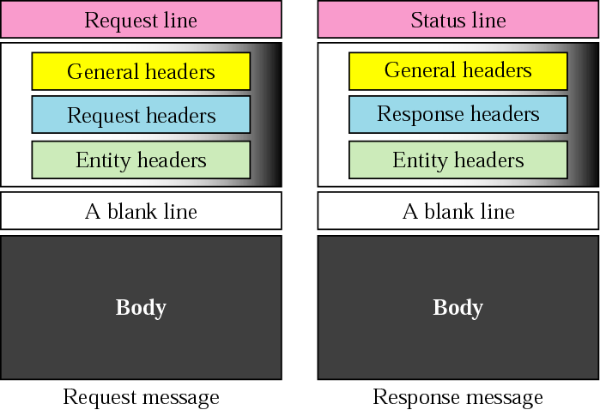
HTTP protocol – message format
two types of messages: request & response
ASCII (human-readable format)

Slide 40
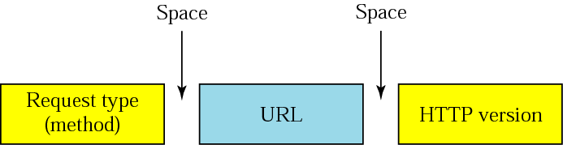
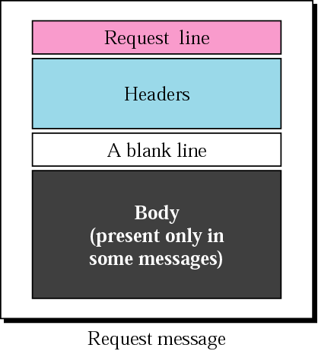
HTTP protocol – message format
HTTP request message
HTTP 0.9 HTTP 1.0 HTTP 1.1
GET – when the client wants to retrieve a document from the server
HEAD – when the client wants some info about a document but not document itself
COPY – copies the file to another location

Slide 41
Method Types
HTTP/1.0:
GET
POST
HEAD
asks server to leave requested object out of response
i.e. request info about a doc
HTTP/1.1:
GET, POST, HEAD
PUT
uploads file in entity body to path specified in URL field
DELETE
deletes file specified in the URL field

Slide 42
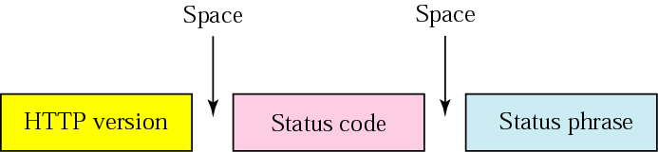
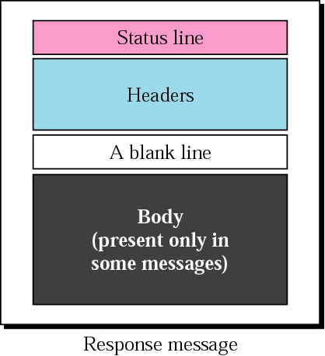
HTTP protocol – message format
http://www.w3.org/Protocols/HTTP/HTRESP.html
HTTP response message
explains the status code
in text form
200 OK – request succeeded
301 Moved Permanently – object moved
400 Bad Request – not understood by server
404 Not Found – req. document not found

Slide 43
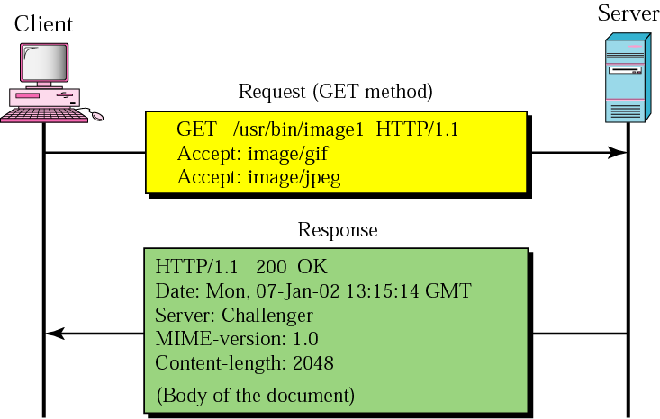
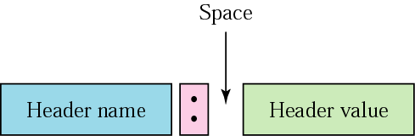
HTTP messages – an example
This example retrieves a document.
We use the GET method to retrieve an image with the path/usr/bin/image1.
The request line shows the method (GET), the URL, and the HTTP version (1.1).
The header has two lines that show that the client can accept images in GIF and JPEG format.

Slide 44
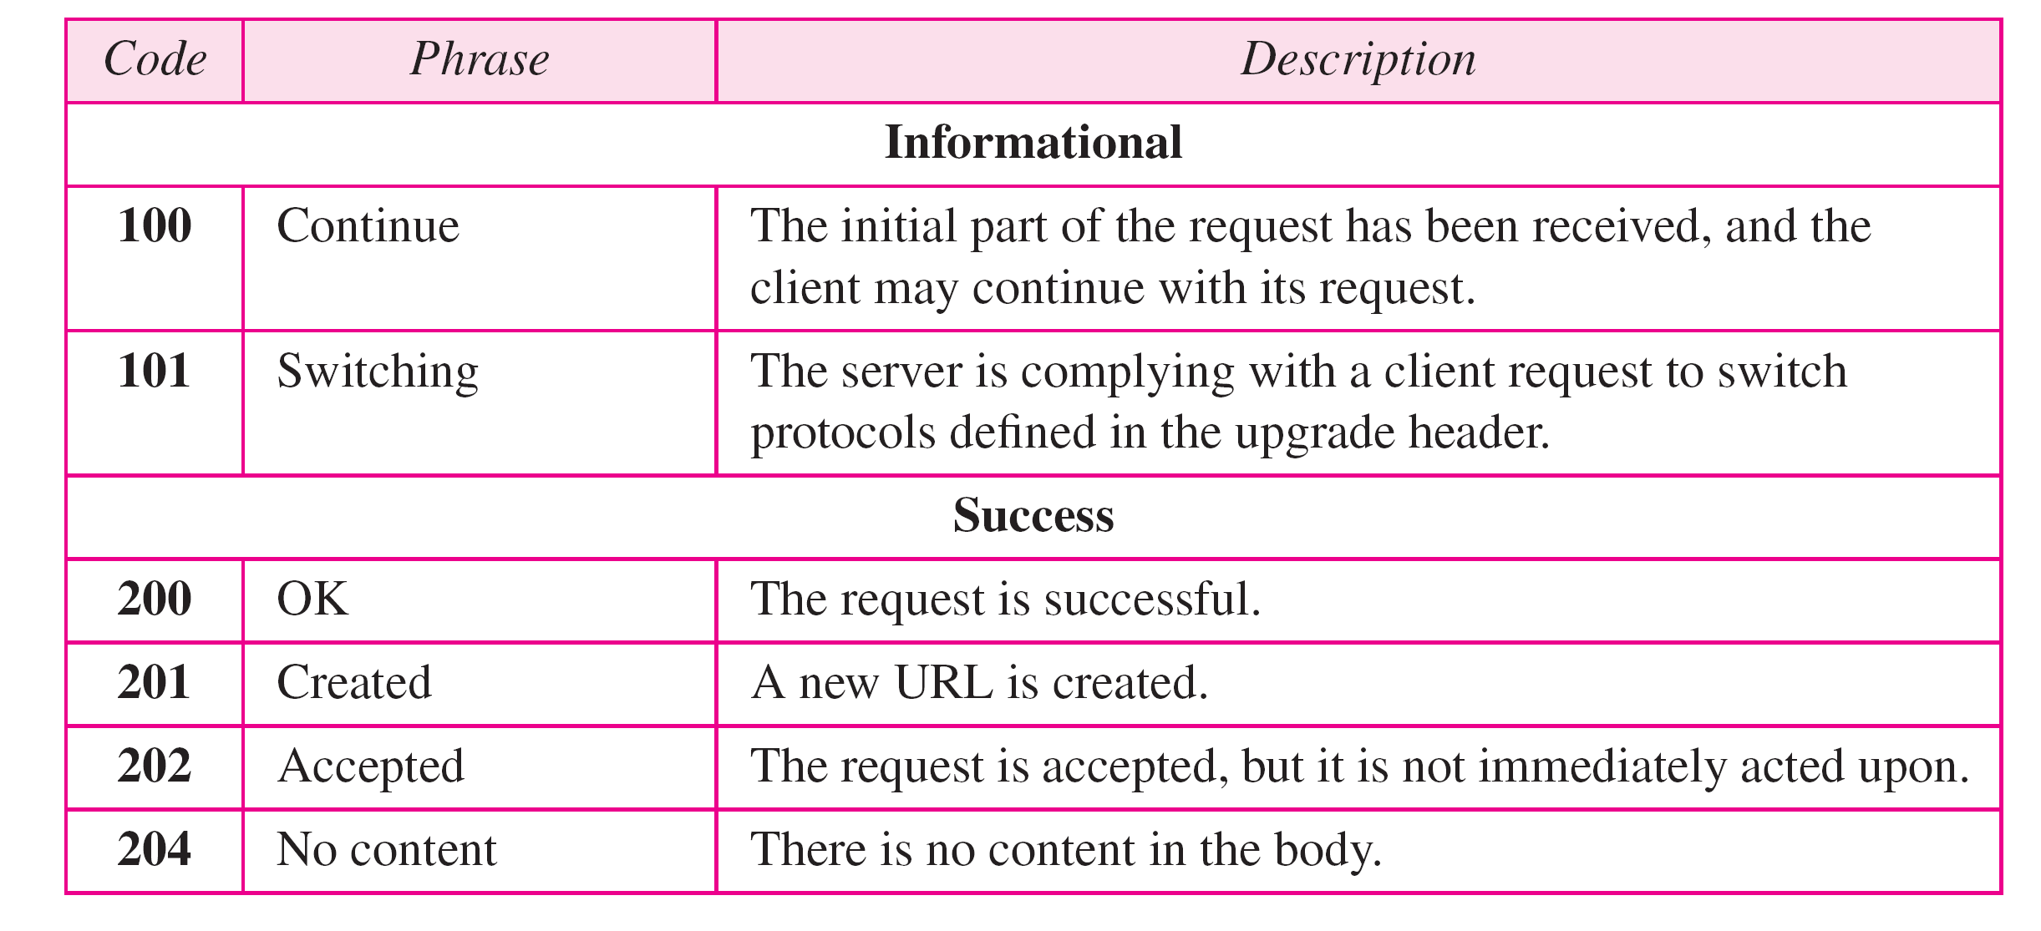
HTTP response status codes
status code appears in 1st line in server-to-client response message.
some sample codes:

Slide 45
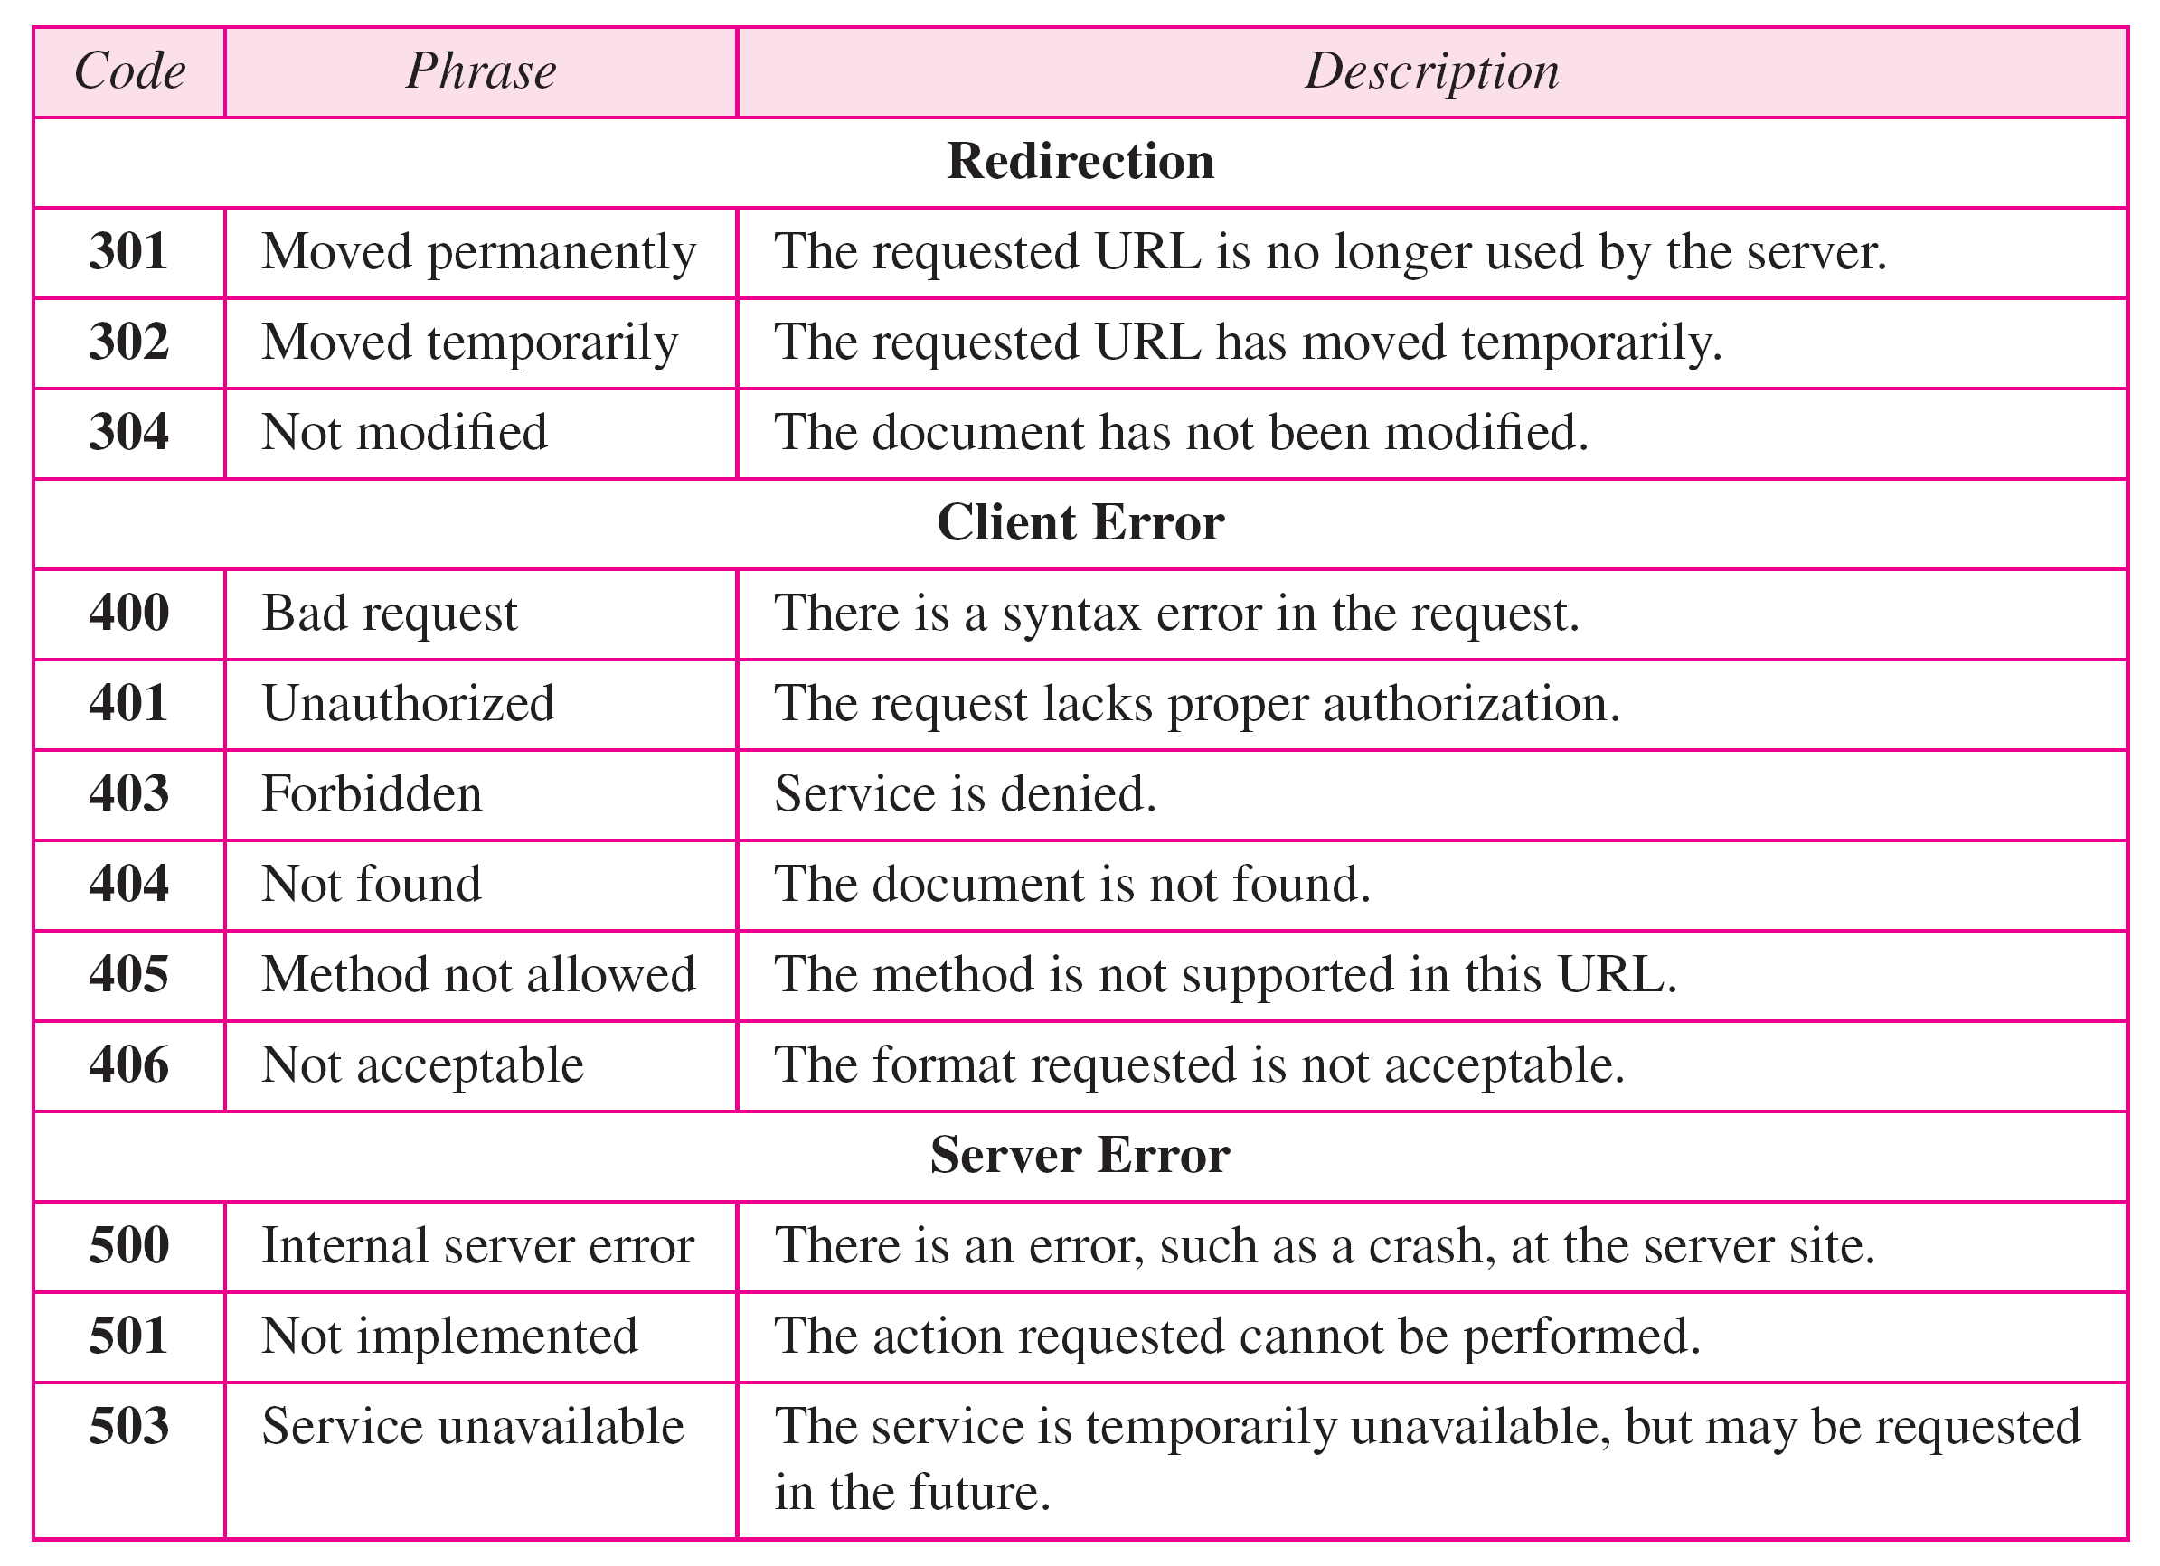
HTTP response status codes

Slide 46
Other HTTP request messages
POST method:
web page often includes form input
user input sent from client to server in entity body of HTTP POST request message
HEAD method:
requests headers (only) that would be returned if specified URL were requested with an HTTP GET method.
PUT method:
uploads new file (object) to server
completely replaces file that exists at specified URL with content in entity body of POST HTTP request message
GET method (for sending data to server):
include user data in URL field of HTTP GET request message (following a ‘?’):
www.somesite.com/animalsearch?monkeys&banana

Slide 47
Trying out HTTP (client side) for yourself
1. netcat to your favorite Web server:
% nc -c -v gaia.cs.umass.edu 80 (for Mac)
>ncat –C gaia.cs.umass.edu 80 (for Windows)
opens TCP connection to port 80 (default HTTP server port) at gaia.cs.umass.edu.
anything typed in will be sent to port 80 at gaia.cs.umass.edu
2. type in a GET HTTP request:
GET /kurose_ross/interactive/index.php HTTP/1.1
Host: gaia.cs.umass.edu
by typing this in (hit carriage return twice), you send this minimal (but complete) GET request to HTTP server
3. look at response message sent by HTTP server!
(or use Wireshark to look at captured HTTP request/response)

Slide 48

Maintaining user/server state: cookies
Recall: HTTP GET/response interaction is stateless
no notion of multi-step exchanges of HTTP messages to complete a Web “transaction”
no need for client/server to track “state” of multi-step exchange
all HTTP requests are independent of each other
no need for client/server to “recover” from a partially-completed-but-never-completely-completed transaction
a stateful protocol: client makes two changes to X, or none at all
X
lock data record X
X
OK
update X X’
X’
OK
t’
update X X’’
OK
X’’
unlock X
OK
X’’
time
time
Q: what happens if network connection or client crashes at t’ ?
Notes:
t’

Slide 49
Maintaining user/server state: cookies
Web sites and client browser use cookies to maintain some state between transactions
four components:
1) cookie header line of HTTP response message
2) cookie header line in next HTTP request message
3) cookie file kept on user’s host, managed by user’s browser
4) back-end database at Web site
Example:
Susan uses browser on laptop, visits specific e-commerce site for first time
when initial HTTP requests arrives at site, site creates:
unique ID (aka “cookie”)
entry in backend database for ID
subsequent HTTP requests from Susan to this site will contain cookie ID value, allowing site to “identify” Susan
Notes:
t’

Slide 50
Maintaining user/server state: cookies
client
Amazon server
ebay 8734
usual HTTP request msg
Amazon server
creates ID
1678 for user
cookie file
usual HTTP response
set-cookie: 1678
backend
database
create
entry
ebay 8734
amazon 1678
usual HTTP request msg
cookie: 1678
cookie-
specific
action
access
usual HTTP response msg
one week later:
access
ebay 8734
amazon 1678
usual HTTP request msg
cookie: 1678
cookie-
specific
action
usual HTTP response msg
time
time
Notes:
t’

Slide 51
HTTP cookies: comments
aside
What cookies can be used for:
authorization
shopping carts
recommendations
user session state (Web e-mail)
cookies and privacy:
cookies permit sites to learn a lot about you on their site.
third party persistent cookies (tracking cookies) allow common identity (cookie value) to be tracked across multiple web sites
Challenge: How to keep state?
at protocol endpoints: maintain state at sender/receiver over multiple transactions
in messages: cookies in HTTP messages carry state
Notes:
t’

Slide 52
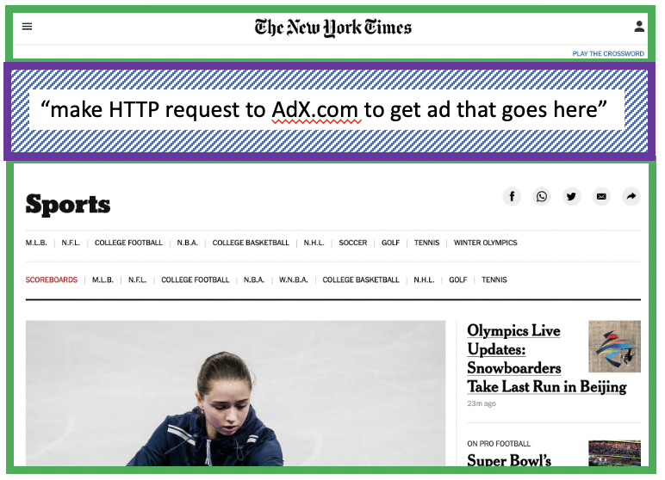
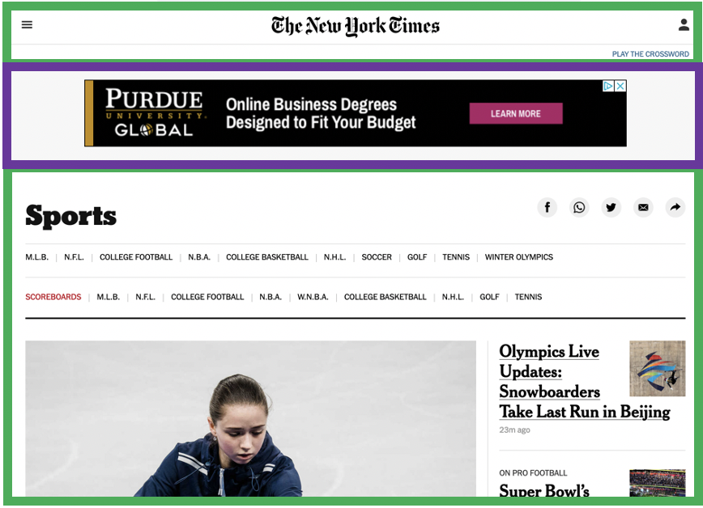


Example: displaying a NY Times web page
1
GET base html file from nytimes.com
2
fetch ad from AdX.com
nytimes.com
4
5
HTTP GET
1
2
HTTP reply
7
display composed page
3
4
6
5
NY times page with embedded ad displayed
AdX.com

Slide 53
Cookies: tracking a user’s browsing behavior
1634: sports, 2/15/22
nytimes.com (sports)
“first party” cookie – from website you chose to visit (provides base html file)
HTTP
GET
HTTP reply
Set cookie: 1634
HTTP GET
Referrer: NY Times Sports
4
5
7493: NY Times sports, 2/15/22
“third party” cookie – from website you did not choose to visit
HTTP reply
NY Times: 1634
Set cookie: 7493
AdX.com
AdX: 7493

Slide 54
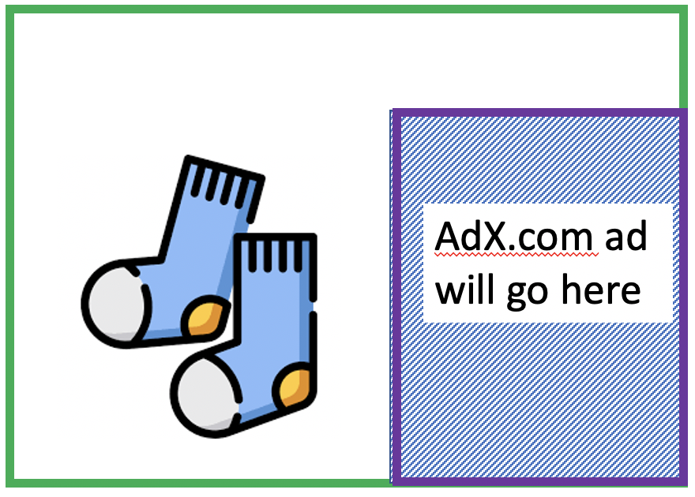
Cookies: tracking a user’s browsing behavior
1634: sports, 2/15/22
nytimes.com
AdX:
tracks my web browsing over sites with AdX ads
can return targeted ads based on browsing history
socks.com
HTTP reply
2
HTTP GET
1
HTTP GET
Referrer: socks.com, cookie: 7493
4
7493: NY Times sports, 2/15/22
5
7493: socks.com, 2/16/22
HTTP reply
NY Times: 1634
Set cookie: 7493
AdX.com
AdX: 7493

Slide 55

Cookies: tracking a user’s browsing behavior (one day later)
1634: sports, 2/15/22
1634: arts, 2/17/22
nytimes.com (arts)
socks.com
HTTP
GET
HTTP reply
cookie: 1634
Set cookie: 1634
HTTP GET
Referrer: nytimes.com, cookie: 7493
4
7493: NY Times sports, 2/15/22
5
7493: socks.com, 2/16/22
HTTP reply
7493: NY Times arts, 2/15/22
NY Times: 1634
Set cookie: 7493
AdX.com
AdX: 7493
Returned ad for socks!

Slide 56
Cookies: tracking a user’s browsing behavior
Cookies can be used to:
track user behavior on a given website (first party cookies)
track user behavior across multiple websites (third party cookies) without user ever choosing to visit tracker site (!)
tracking may be invisible to user:
rather than displayed ad triggering HTTP GET to tracker, could be an invisible link
third party tracking via cookies:
disabled by default in Firefox, Safari browsers
to be disabled in Chrome browser in 2023

Slide 57
References
Computer Networking: A Top-Down Approach
Chapter 2
TCP/IP Protocol Suite
Chapter 22

Slide 58
Thank You

